Slide 1

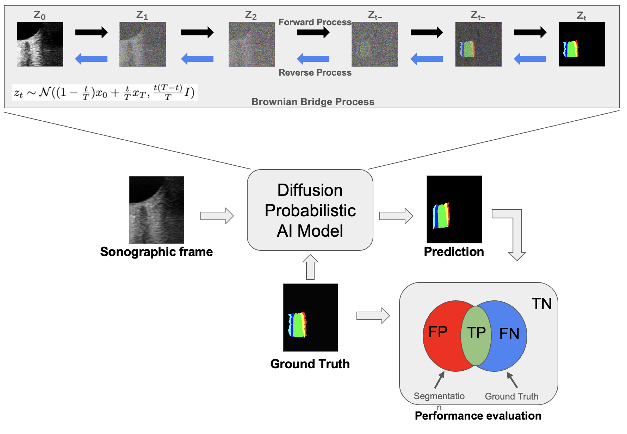
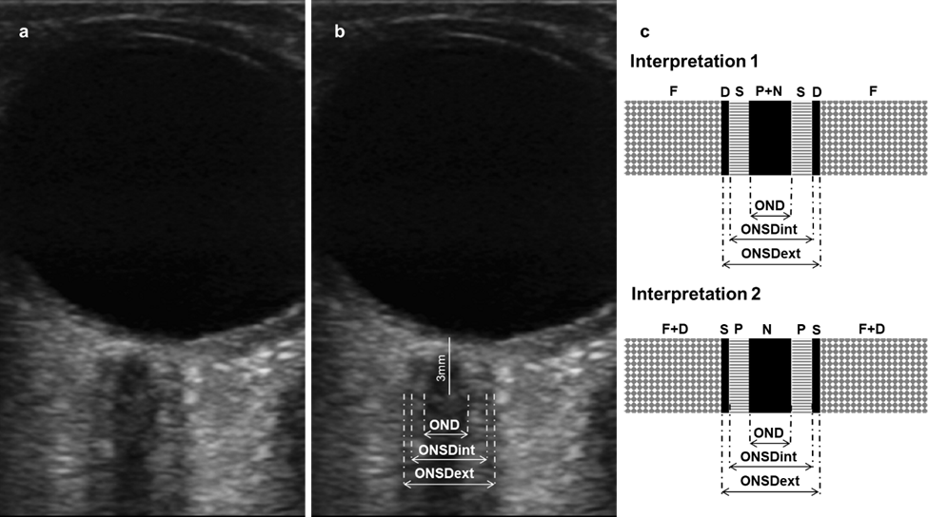
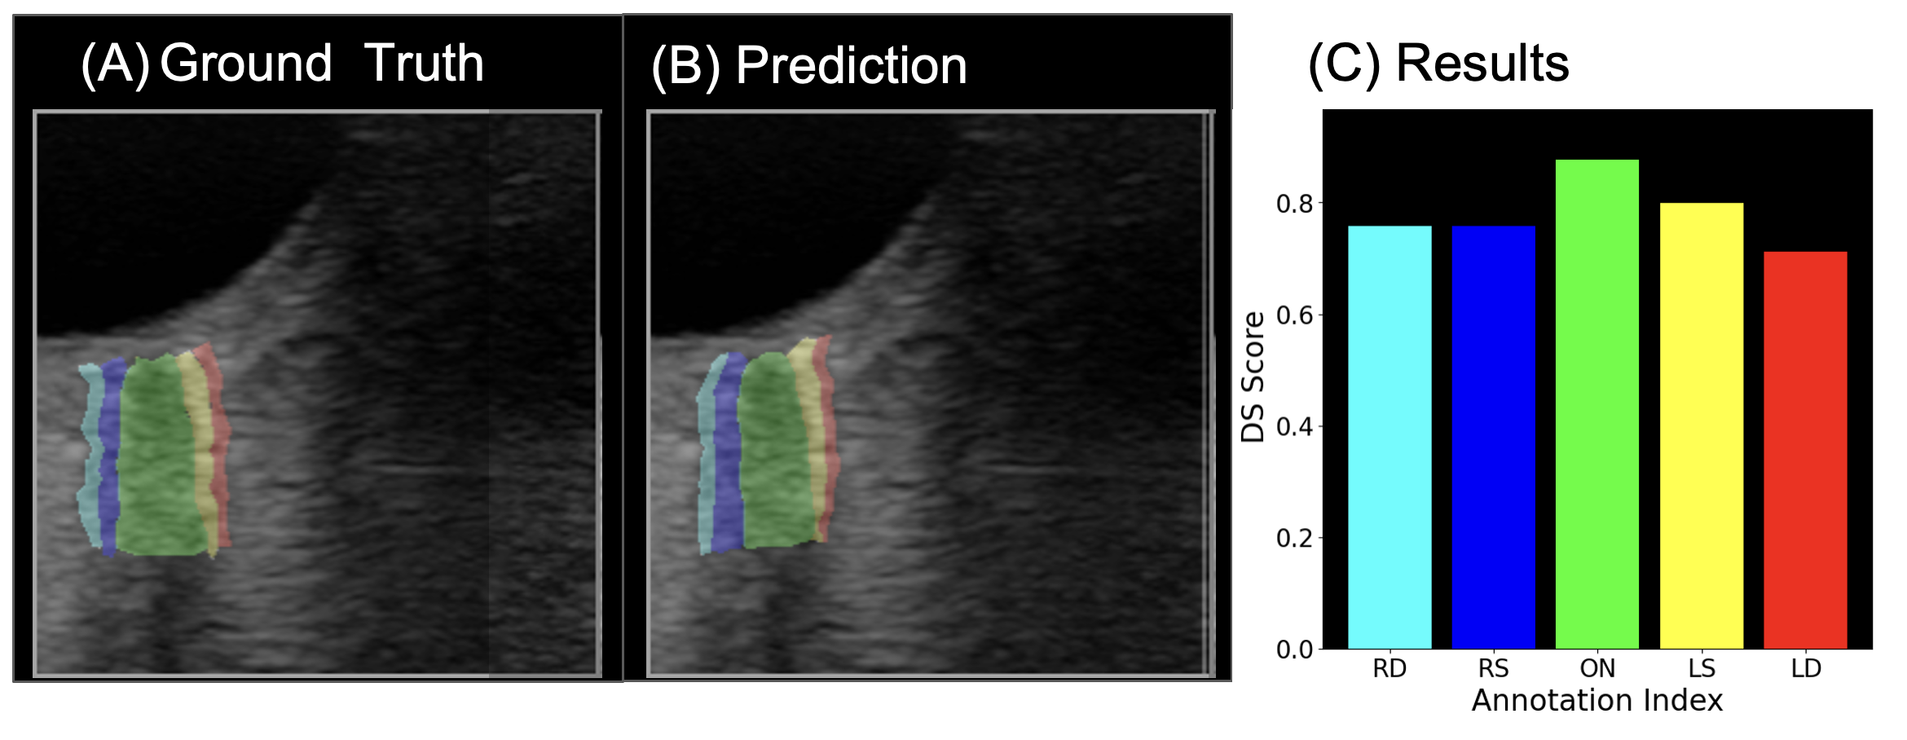
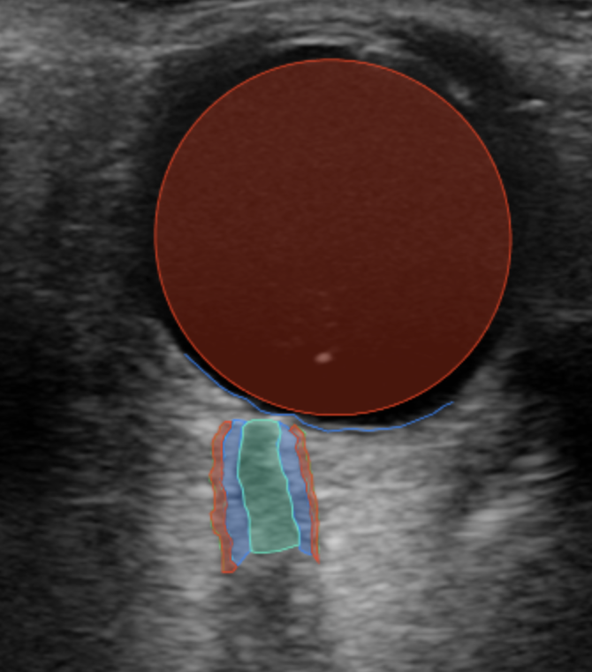
Development of an Automated Algorithm for Optic Nerve Sheath Diameter Measurement Using Transorbital Ultrasound
César E. Escamilla-Ocañas¹, Noelia C. Morales-Cardona¹, Jason Uwaeze², Alireza Akhbardeh³, Mohammad Hirzallah^{1,4}
¹ Division of Neurovascular and Neurocritical Care, Department of Neurology, Baylor College of Medicine, ² Rice University, ³ Department of Diagnostic and Interventional Imaging, University of Texas Health Science Center at Houston, ⁴ Center for Space Medicine, Baylor College of Medicine
Background
Objectives
Sonographic optic nerve sheath diameter measurement is a portable and non-invasive tool that might be excellent for ICP measurement during spaceflight. Its use has been limited by variability in measurement techniques and interpretation. Machine learning might be a useful tool to address these limitations.
Up to 60 % of the astronauts develop spaceflight associated neuro-ocular syndrome (SANS) during long-duration spaceflight.
A cephalad fluid shift in microgravity causing chronically elevated intracranial pressure (ICP) has been described as a potential etiology.
ONSD serves as a sensitive proxy for ICP measurement and increased ONSD has been reported in astronauts (Figure 1).
Sonographic ONSD measurement is a portable and non-invasive tool that might be excellent for ICP estimation during spaceflight.
Its use has been limited by a variability in image acquisition and measurement techniques.
Machine learning could be a useful tool to address these limitations.
To develop an automated machine learning algorithm capable of conducting automated ONSD measurements which are comparable to the ones obtained by experienced physicians.
Methods
Two physicians independently selected images suitable for ONSD measurement
Method 1 (v7lab+expert): V7lab software were used for semi-automated segmentation and annotation of the visible anatomical structures (optic nerve, optic nerve sheath, retina, vitreous) and were audited by expert (Figure 1).
Method 2: A Brownian Bridge Diffusion Model (BBDM) was used to automatically segment and predict annotations as a second method. Leave one out cut cross validation was utilized for algorithm training (Figure 2).
The overlap and similarity between BBDM and v7lab+expert segmentations was compared using dice similarity measure (0=no overlap; 1=identical).
Results
20 de-identified transorbital images were included.
Method 1: [cesar which method in v7 you used for annotation/segmentation? There are multiple choices]
Method 2 configuration: BBDM Model was trained using the Adam optimizer on a single NVIDIA A100 GPU with 6912 CUDA cores, and 40GB RAM; Training time: < 2 hours ; Epochs = 100
Dice similarity indices to compare BBDM and v7lab+expert methods for different anatomic structures: RD: 0.76, RS: 0.76, ON: 0.88, LS: 0.80 and LD: 0.71
Figure 3. Sonographic frame annotation framework for automatic ONSD measurements using BBDM.
Conclusions
The utilization of BBDM can obtain ONSD measurements with great similarity to v7lab+expert.
Further validation of BBDM algorithm is needed.
Automation of ONSD measurements might be a valuable tool for crews to measure estimate ICP. This could make the monitoring for SANS during space missions achievable.
References
Figure 1. Axial ultrasound image (a) with ONSD internal and external measurements (b) measurements are based on different anatomic definitions (c). OND: optic nerve diameter. ONSDint: ONSD internal, ONSDext: ONSD external, F: fat, D: dura, S: subarachnoid space, P: pia, N: nerve.
Figure 3. (A) Ground Truth: ONS segmentation and annotations by v7lab, validated and corrected by physicians. (B) VVDM predicted annotations. (C) Performance evaluation of BBDM using dice similarity (DS), where right dura (RD)m right subarachnoid (RS), optic nerve (ON), left dura (LD), and left subarachnoid (LS) are displayed along x axis, and corresponding DS scores along the y axis.
V7labs Software: The AI Data Engine for Computer Vision & Generative AI (https://www.v7labs.com/).
Li, B., Xue, K., Liu, B., & Lai, Y. K. (2023). BBDM: Image-to-image translation with Brownian bridge diffusion models. In Proceedings of the IEEE/CVF Conference on Computer Vision and Pattern Recognition (pp. 1952-1961).
Figure 2. Segmented image of the ONSD using v7lab software.

